Slide 1
ETL

Slide 2
Online Transactional Processing
Data Repository Type
OLTP
OLAP
Online Analytical Processing
1. Works best with Inmon style of data warehouse.
1. Works best with Kimball style of database warehouse.
2. Is best when you have data that is constantly changing, for example a bank where the amount of money in people’s accounts changes often.
2. Is best when you have data that is more static and not subject to much change.
3. As the name suggests, this data repository type is made so that you can have greater ability to analyze your data easily.
3. As the name suggests, this data repository type is more effective for adding and updating data transactions.

Slide 3
ETL
1. Extract - Extracts data stored in various data sources (including databases and files).
2. Transform - Transforms the data. Types of transformations include cleaning the data, removing duplicates, changing formats, filtering out certain data, aggregating the data, and more.
3. Load – Loads the data into the data warehouse of your choosing.
One reason ETL might need to be used is so you can get the data from one or more OLTP databases and transform that data into an OLAP data warehouse so that the data is in one place and is in a structure more suited for analysis.

Slide 4





Environments
Unix Shell
Bash Shell
Powershell
Command Prompt
These are several of the different types of environments that you can use to run an ETL process for your data.
Think of environments as areas to run code for different types of languages if you have set up and installed the programming language on your machine.

Slide 5


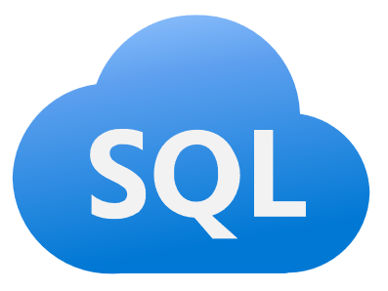

Programming Languages
Python
Java
SQL
XQuery
Along with environments, there are more than a few different types of coding languages that you can use for ETL.
Each of these different coding languages have their strengths and weakness when it comes to using them for ETL and other tasks.

Slide 6
Data Sources
Data can be stored in many different data sources. The most common are databases and files.
Databases
Files
Relational databases are often used for OLTP and then that data is extracted, transformed, and loaded into an OLAP data warehouse for easier analysis.
Common relational databases include:
Oracle
SQL Server
MySQL
DB2
There are many types of files that can be used as data sources. These include:
Flat files (simple Excel or CSV files)
XML (Extensible Markup Language)
JSON (JavaScript Object Notation) files.
The important thing is that ETL can be used to bring data from these different types of data sources so that the data can be used together.

Slide 7
Sources
https://www.guru99.com/etl-extract-load-process.html

